Slide 1
Linked List

Slide 2
Linked List
Linked list is a dynamic linear data structure. It consists of list or chain of objects (or data elements), each pointing to the next object by means of a pointer.
Each object or data element of the linked list is called node.
Each node contains the data and the memory address or location of the next node in the list.

Slide 3

Cont.
Thus each node of the linked list has two parts:
i) Data part: It contains actual data. It can consist of one or more fields. These fields are known as data, information, value, cargo, or payload fields. A node may contain data of any type. However, all nodes of the list contain the same type data.
ii) Link part: It contains the memory address of the next node. It is known as next link or next pointer. It points to the next ne previous node also for double linked list) in the list. Each node is linked logically with the next node through next pointer. If the next node, then a NULL value is stored in it, to mark the end of list.
A simple linked list is shown in the following figure:

Slide 4
Advantages of Linked List
Following are some advantages of linked lists as compared to arrays:
Dynamic Data Structure:
Linked list is a dynamic data structure, which can grow and shrink (by allocating and de-allocating of memory during the execution of the program. So there is no need to define an initial size in the source code for a linked list. On the other hand, an array is a static data structure which has a fixed size. Size of an array is fixed; therefore, we need to know the upper limit of maximum size beforehand in order to declare an array. This can lead to wastage of memory.
Implementation:
Implementation using stack and queue.

Slide 5
Cont.
Insertion and Deletion of nodes:
Insertion and deletion of nodes of linked list are comparatively easier. There is no need for shifting of nodes during insertion and deletion operations of nodes. When a node is inserted or removed, only the link or pointer field of the next node is updated. On the other hand, deletion and insertion of elements in array are difficult. It needs the shifting of elements in an array for insertion and deletion operations.
Memory Utilization:
In case of array, there is a lot of memory wastage. For example, if we declare an array of size 50 and store only 16 elements in it then space of 34 elements are wasted. There is no such problem in linked list as memory is allocated only when required. So linked list data structure provides efficient memory utilization.

Slide 6
Disadvantages of Linked Lists
Wastage of Memory:
Linked lists may use more memory than arrays because pointers are also stored along with data elements. Extra memory space for a pointer is required with each data element of the list.
No Random Access:
Random access of nodes is not possible in a linked list. We have to access nodes of linked list sequentially starting from the first node. For example, if we want to access a node at position 'n', then we have to traverse all the nodes before it. However, random access of an element is possible in case of an array.

Slide 7
Disadvantages of Linked Lists(Cont.)
Reverse Traversing:
In singly linked list, reverse traversing is difficult (i.e. traversing singly linked list from end). It can be traversed only from beginning. However, doubly linked list is somewhat easier to traverse from end, however it consumes more storage space for back pointer. In an array, reverse traversing is easier than linked list.
Time Complexity:
Individual nodes are not stored in the contiguous access individual nodes within the locations. More time is required to access individual nodes stored in the contiguous locations. So less time is required to access individual element of an array.

Slide 8
Types of Linked List
There are three common types of Linked List:
Singly Linked List.
Doubly Linked List.
Circular Linked List.

Slide 9
Singly Linked List
A type of linked list in which each node contains data and the address of next node, is called singly linked list.
Sometimes, it is also simply called single linked list.
It is named as singly linked list because its each node contains a single link (address) of the next node and does not contain the address of the previous node.
It can be accessed or visited from beginning to its end i.e. only in one direction.
It is also known as one-way list or one-way chain.

Slide 10
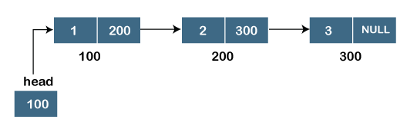
Singly Linked List (Cont.)
Each node consists of at least two fields.
The first field the data. This field is called data field (more than one data fields can be used to store information).
The second field contains the pointer or link (memory to the next node in the list. This field is called next link or next pointer field.

Slide 11
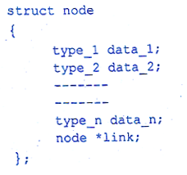
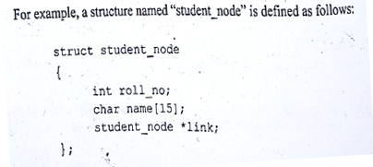
Declaring Structure of a Node
Before creating a new node, its structure is declared / defined. Following is the syntax to declare the structure of a node of a linked list in C++:

Slide 12
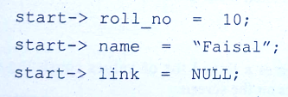

Accessing Data of a Node
The operator “->“ (hyphen and greater than sign) is used to access the data of pointer type object (node of a linked list).
In order to store data values in fields roll no', 'name' and 'NULL' value to link pointer of the node 'start', the assignment statements are as follows:

Slide 13
Code
// Node of a doubly linked list
class Node {
public:
int data;
// Pointer to next node in LL
Node* next;
};

Slide 14
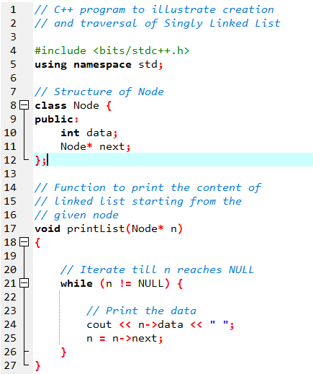
Code

Slide 15
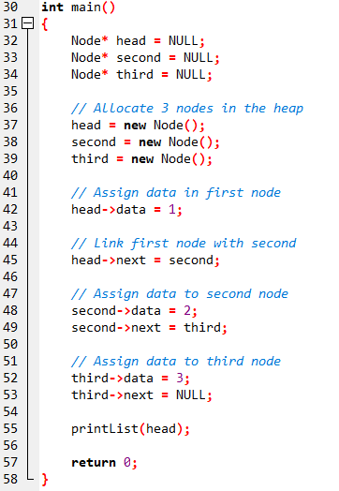

Code

Slide 16

Doubly Linked List.
The linked list in which each node contains the address of both next and the previous node. It can be visited in both directions.
Therefore, it is the list in which each node contains the addresses of both the next previous node, is called doubly or double linked list.
This type of linked visited or traversed in both directions i.e. in forward as well as in backward, it is also called a bi-directional linked list or two-way linked list.

Slide 17
Doubly Linked List (Cont.)
Node Structure of Doubly Linked List contains at least following three fields:
First field contains the address of the previous node in the list. It is often called previous or backward link field.
Second field contains the actual data or information of the node.
Third field contains the address of the next node in the list. It is often called next or forward link field.
* Previous | Data | * NEXT

Slide 18
Applications of Doubly Linked List
It can be used in navigation systems where forward and backward navigation is required.
It is used by web browsers to implement backward a navigation of visited web pages by clicking BACK and Forward buttons.
The browser cache stores pages (next and previous).
It is also used by various applications like MS Word to implement undo and Redo functionality.
A stack, hash table, and binary tree can be implemented using linked list.
It is also used to represent various states of a game. ented using a doubly

Slide 19
Advantages of Doubly Linked List
We can traverse doubly linked list in both directions i.e. from starting to end and as well as from end to starting. We know that backward traversal of nodes in singly linked list is not possible.
It is the easiest data structure to implement. Insertion and deletion operations are easier than those of singly linked list. For example, to delete a node in a singly linked list, we need the pointer to its previous node. But in case of doubly linked list, we just need the pointer to the node being deleted.
Reversing the list is simple and straightforward.
The doubly linked list can be used to represent other data structures as well. For example, hierarchical structure can easily be represented using doubly linked list. Similarly, graphs can be represented using ou linked list.

Slide 20
Disadvantages of Doubly Linked List
Each node of doubly linked list requires extra space for previous node link.
Insertion and deletion operations takes more time than singly linked list.
While manipulating the list, extra care is needed to modify both links of a node. For example, in insertion of a node, we need to modify previous pointer together with next pointer.

Slide 21
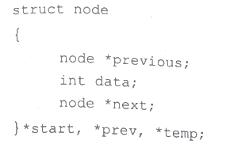
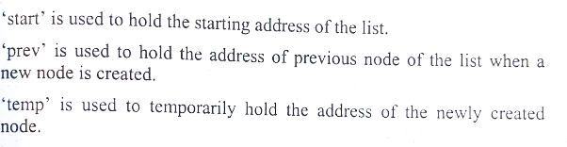
Representation of a Node

Slide 22
Circular Linked List

